Slide 1
Paralegal
Search Strategies and Reliable Resources

Slide 2
Before you begin an internet search, it is best to spend a few minutes thinking about what words and phrases will return the best results:
List key concepts/terms
Phrase searching
Boolean operators
“laymen’s” terms vs. professional terms
Ex. Abuse of authority or malfeasance.
Consider synonyms, alternate or related terms.
Ex. Temporary restraining order, provisional remedy
Note acronyms or abbreviations.
Correct spelling is important!
If terms have more than one word enclose the phrase in “quotation marks”.
Otherwise most databases will put the word OR in-between the words, broadening your results list.
Ex. Provisional remedy= 204,000 results
“provisional remedy” = 53,500 results.
AND – narrows the search by requiring both terms to be included in an article.
OR – broadens the search. Either word can appear in an article.
Ex. malfeasance OR “abuse of authority”
NOT - narrows the search by excluding articles that include the word.
Ex. “star trek” NOT “deep space nine”

Slide 3
Not all information on the internet is worth using. Websites must be evaluated for:
Tutorials -
Tips and Tricks for Evaluating Websites
Evaluating Website YouTube video - David L. Rice Library
Currency – when was the information written?
Relevance – does the information relate to your topic?
Authority – who is the author/sponsor/publisher/source?
Accuracy – can you verify the information in another source?
Purpose – what is the website for? To inform, teach, sell, entertain, or persuade?

Slide 4
Links to reliable websites
Introduction to Basic Legal Citation - Cornell University Law School
Federal Laws and Regulations
Supreme Court of the United States
Internet Legal Research Guide A categorized index of select legal websites.
Duke University Law Library Research Guides
National Federation of Paralegal Associations
NALA- the Paralegal Association

Slide 5
Research Library
Access through the SuperMoodle
Available 24/7.
Credible and reliable sources.
Scholarly journals, professional & trade publications, magazines, newspapers.
Different results than the free internet returns.
Basic or Advanced search options.
Tutorial videos are located in the ProQuest section of the AHED Library Resources.
ProQuest helpguide links:
ProQuest Basic Search Helpguide
Create a My Research account
Full Text Journals available:
Criminology/Law enforcement – 45
Law-international – 41
Law - 263

Slide 6
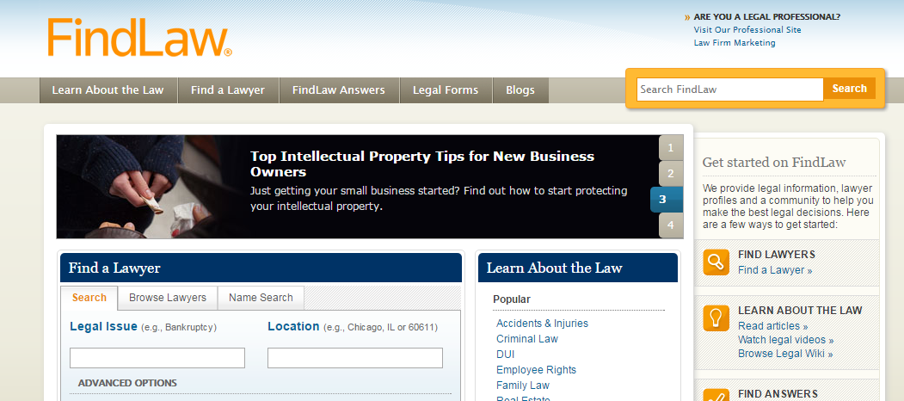
Using Findlaw.com for legal research
Click on “Learn about the Law” on the right side of the taskbar

Slide 7
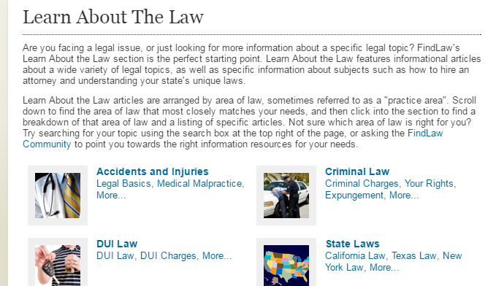
Using Findlaw.com pg. 2
Click on
“State Laws”

Slide 8
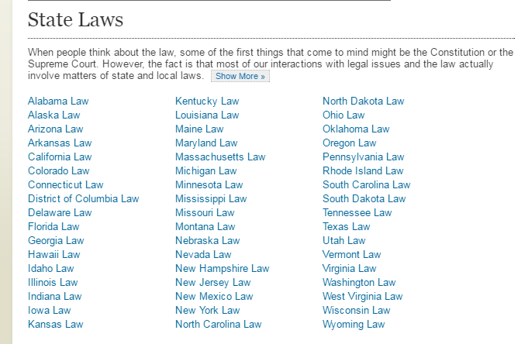
Using Findlaw.com pg.3
Click on your
jurisdiction (your state)
Then click on the
legal subject you want to
Research.

