Slide 1
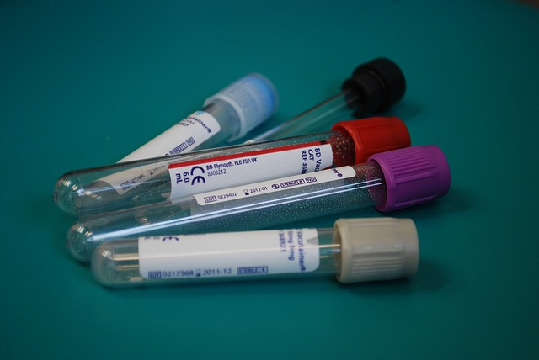
Medical Laboratory Technician

Slide 2
Not all information on the internet is worth using. Medical information must be evaluated for:
Tutorials -
National Library of Medicine tutorial on evaluating health information on the internet
Evaluating Website YouTube video - David L. Rice Library
Tips and Tricks for Evaluating Web Sites
Left click on links to open
Currency – when was the information written?
Relevance – does the information relate to your topic?
Authority – who is the author/sponsor/publisher/source?
Accuracy – can you verify the information in another source?
Purpose – what is the website for? To inform, teach, sell, entertain, or persuade?

Slide 3
Research Library
Access through the SuperMoodle
Available 24/7.
Credible and reliable sources.
Scholarly journals, professional & trade publications, magazines, newspapers.
Different results than what the free internet returns.
Basic or Advanced search options.
ProQuest helpguide links:
Medical Database - search tips
Create a My Research account
Left click on links to open

Slide 4
Professional Resources
Advance Healthcare Network Free resources for the laboratory professional. Two free emagazines. http://laboratory-manager.advanceweb.com/
Clinical Laboratory Improvement Amendmenst (CLIA) Centers for Medicare and Medicaid Services regulates all laboratory testing, except research.
Medical Lab Observer access to past issues. http://www.mlo-online.com/archives
Medical Lab Science Guide - Idaho State University A guide to online resources.
Occupational Outlook Handbook information on education, pay, working conditions, etc.
Medical Lab Management magazine archives https://www.medlabmag.com/issues/
Left click on links to open

Slide 5
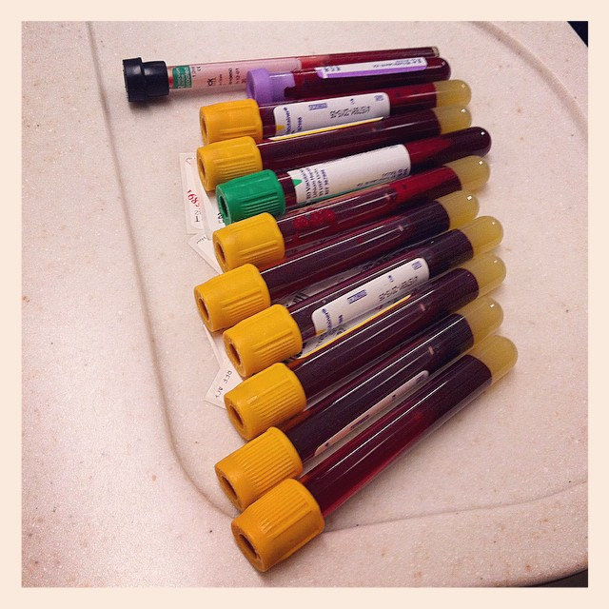
Phlebotomy Resources
Vein and Artery Map This site, from the Vascular Disease Foundation, provides an interactive map of veins and arteries throughout the body.
Center for Phlebotomy Education
Blood Collection: Routine Venipuncture and Specimen Handling This tutorial, from the University of Utah Health Sciences Library, shows the step-by-step process of collecting blood samples. The site also has a chart for quickly identifying blood sample tube types.
Left click on links to open

Slide 6
Hematology Resources
Basic Hematology Web Tutorial This tutorial, created by the University of Virginia School of Medicine, covers hematopoiesis, red blood disorders, and white blood disorders.
Blood Banking tutorial This tutorial was created by the University of Utah Health Sciences Library and provides a comprehensive overview of blood banking procedures.
American Society of Hematology Includes the latest research and professional development information for hematologists.
FDA Blood & Blood Products Information from the FDA about the collection and regulation of blood and blood products.
Blood Bank Guy Transfusion Medicine Education
BloodLine Image Atlas
Hematology Outlines Online textbook and atlas
Left click on links to open

Slide 7
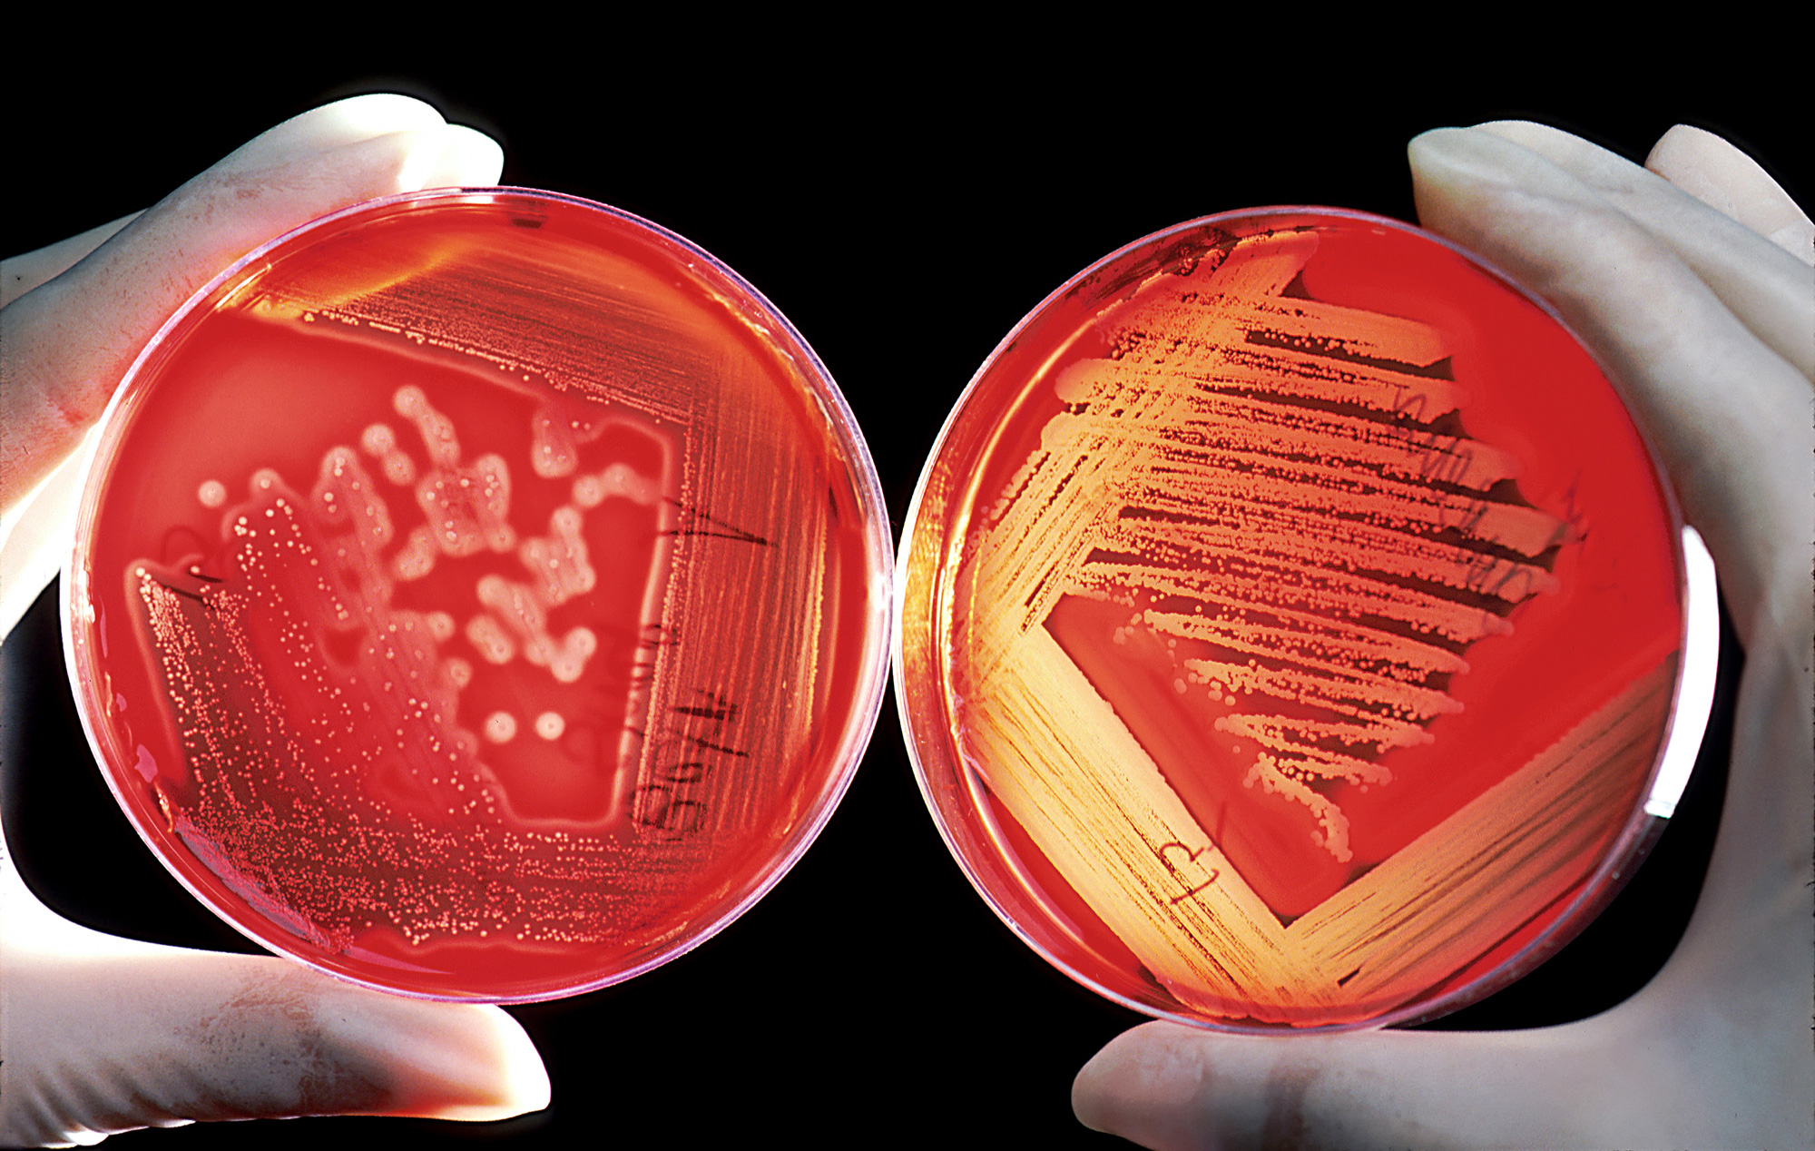
Microbiology Resources
Interactive Tour of a Cell from the National Science Foundation https://www.nsf.gov/news/overviews/biology/interactive.jsp
American Society for Microbiology ASM Clinical Microbiology portal
Centers for Disease Control and Prevention Our nation′s premier health promotion, prevention, and preparedness agency and a global leader in public health.
DPDx - CDC Parasitology Diagnostic Website developed and maintained by CDC’s Division of Parasitic Diseases and Malaria, with the goal of using the internet to strengthen diagnosis of parasitic diseases.

